Slide 1
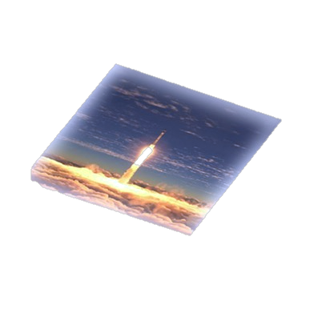
InSpace Manufacturing What’s Different Now?
InSpace Production Applications
Mr. Kevin Engelbert, NASA InSPA Portfolio Manager
Ms. Lynn D. Harper, NASA Ames Research Center, Strategic Integration Advisor
Dr. Rose Hernandez, Science Director for In-Space Product Applications at the International Space Station (ISS) National Lab
Mr. Curtis W. Hill, NASA MSFC ESSCA - Lead- Semiconductors, In Space Production Applications (InSPA) curtis.w.hill@nasa.gov
Dr. Daniel Rasky, NASA Ames Research Center, Senior Scientist, Director of NASA Space Portal
Mr. Gary Rodrigue, Consultant
24 Jan 2024

Slide 2
How is Gravity Impeding US Industry?
InSpace Production and Manufacturing Demand
500+ CEOs + CTOs
Case Studies
NASA µg Database
Based on work 2013-2016 by NASA’s Emerging Space Office and Space Portal
enabled by Dr. Alex MacDonald/Program Executive of the Emerging Space Office, Lynn Harper/Space Portal/Study Lead, Dr. Ioana Cozmuta’s comprehensive research,
with due diligence and insights from Dr. Daniel Rasky, Bruce Pittman, and Mark Newfield
and hundreds of experts in dozens of organizations throughout America
2013

Slide 3
NASA ESO Findings 2014 Demand Trends in High Tech
Even more true in 2024
more bandwidth
faster processors
greater energy efficiency
specific wavelength applications (lasers)
more processing power in smaller volumes
better performance in more extreme environments
more effective pharmaceuticals and treatments
atomic and molecular level precision No end to that demand in sight
These demands push materials and processes to the point where defects at the atomic and molecular level matter ... this is where microgravity can help.

Slide 4
Turning Discoveries into Applications for the Benefit of All Biomanufacturing & Advanced Materials in Low-Earth Orbit
In Space Production Applications (InSPA)

Slide 5
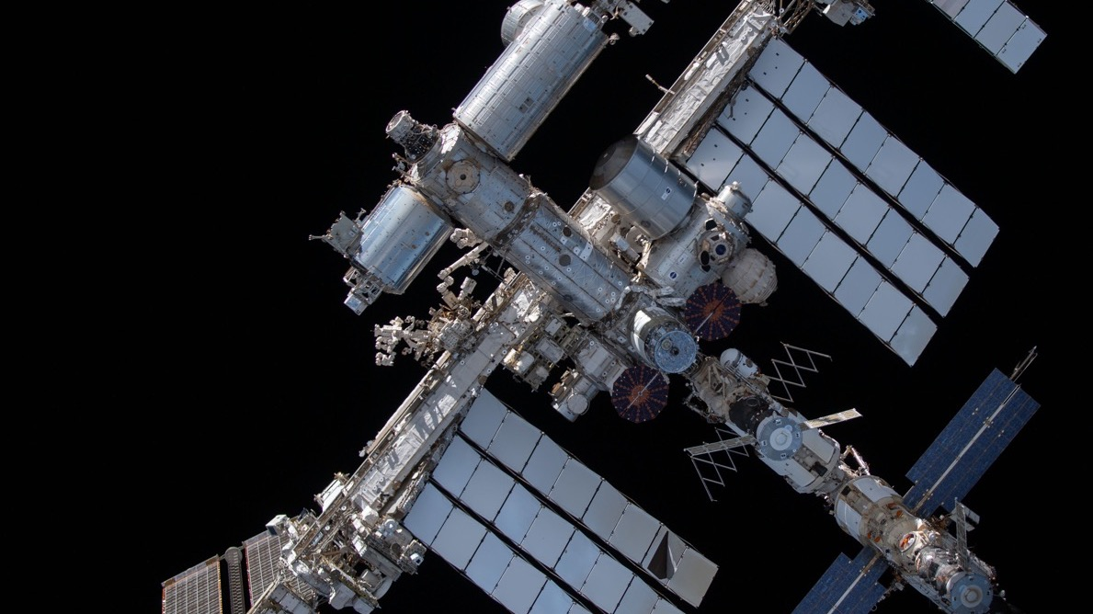
InSpace Production Application (InSPA) GOALS
Serve U.S. national interests by developing materials and technologies that strengthen industry leadership, improve national security, and create high-quality jobs.
Provide benefits to humanity by developing products that significantly improve the quality of life for people on Earth.
Accelerate development of the space economy in LEO by stimulating demand for scalable and sustainable non-NASA utilization of future commercial LEO destinations.
Approach: Increase national workforce proficiency in orbital manufacturing through inflight experience in collaboration with the ISS National Lab
5
Notes:
Slide #4- Alright, lets discuss goals.
Number 1 – we want to develop materials and technologies that strengthen US industry leadership.
Number 2 ( and the one that really motivates me everyday) is that we want to provide benefits to humanity through the advanced materials and biomanufacturing that we sponsor.
Finally, is give the people what they need. Let's stimulate the demand and let's scale it and make it sustainable.
How do we do it? Through utilization of the ISS National lab and independently validating a superior product that was built in microgravity versus the ground control.

Slide 6
InSPA - In Space for Earth
Applies lessons from 50 years of microgravity (uG) research and expertise to enable In-Space Manufacturing of advanced materials and products for use on Earth.
Invests in US innovators through annual proposal opportunities to develop high value applications that benefit the nation, humanity, and the economy over the next 10 years – and the proficiency to achieve them in space.
Technical support to help US businesses successfully navigate Technology and Manufacturing “Valleys of Death” in space until private investment takes over.
Collaborative implementation with ISS National Lab. Recruiting subject matter experts from USG Agencies, Industry, and Academia to inform national priorities and accelerate learning in µg.
Workforce development through hands-on flight experiences in multiple areas researching, developing, testing, and operating high tech payloads in parabolic aircraft, suborbital, and orbital space for solutions that benefit Earth.

Slide 7
InSPA: Build. Fly. Learn. Fix. Improve. Iterate. Repeat till Succeed. Through Technologies Valleys of Death to Applications via Practice in Space
Primarily Government
IRAD, Angels, Philanthropists
Primarily Government
Some Private Investors
Enabling Government Support
More Private Investors Government as Customer
HIGH
Orange shows transition to Inspace Production Applications (InSPA)
Technology
Valley of Death
Manufacturing Process
Valley of Death
In Space Manufacturing and Scaleup Demos
Private Investment Risk
DISCOVERY
Space Investors by TRL
LAB POC
Transition to Application
Transition to Manufacturing
SPACE
POC
SPACE
DEMO
Primarily Private Investors
LOW
TRL 1
TRL 2
Application Idea Formulated
TRL 3
TRL 4
Lab Testing and µG Feasibility
TRL 5
Validate in space
TRL 6
TRL 7
Manufacture in space
TRL 8
Scaleup
in
Space
TRL 9
System Proved and Operating in Space with Sales
Flights on ISS
NASA SMD and ISS National Lab SBIR + STMD Flight Opportunities ISS National Lab+ ISS NRA > ISS Flight >
COMMERCIAL/APPLICATIONS
µG DEMO PROOF OF CONCEPT & QUALITY
COMMERCIAL/
APPLICATIONS TRANSFERRED
BASIC and APPLIED RESEARCH
NASA Biological and Physical Sciences, ISS National Lab
Notes:
There are two Valleys of Death in inspace manufacturing. One is the performance of the manufacturing hardware. The other is control of the manufacturing processes. It is not enough to become proficient in just one of these. If the government does not invest between TRL 5-8, it is unlikely that private investors will either. From a private investor standpoint, Inspace manufacturing is an expensive, high risk, and unfamiliar type of investment and very few will pay to see a proof of concept in space. Once the proof of concept has been demonstrated in space to a certain standard, private investors are likely to be willing to invest (if the costs vs profits works).

Slide 8
So … about Space and Materials … What’s Different Now?
Notes:
Ask for a show of hands: How many people here can help a company get a payload to space? That’s what’s different now.
Ask for a show of hands: How many people here are affected by the CHIPS Act? That’s what’s different now.

Slide 9
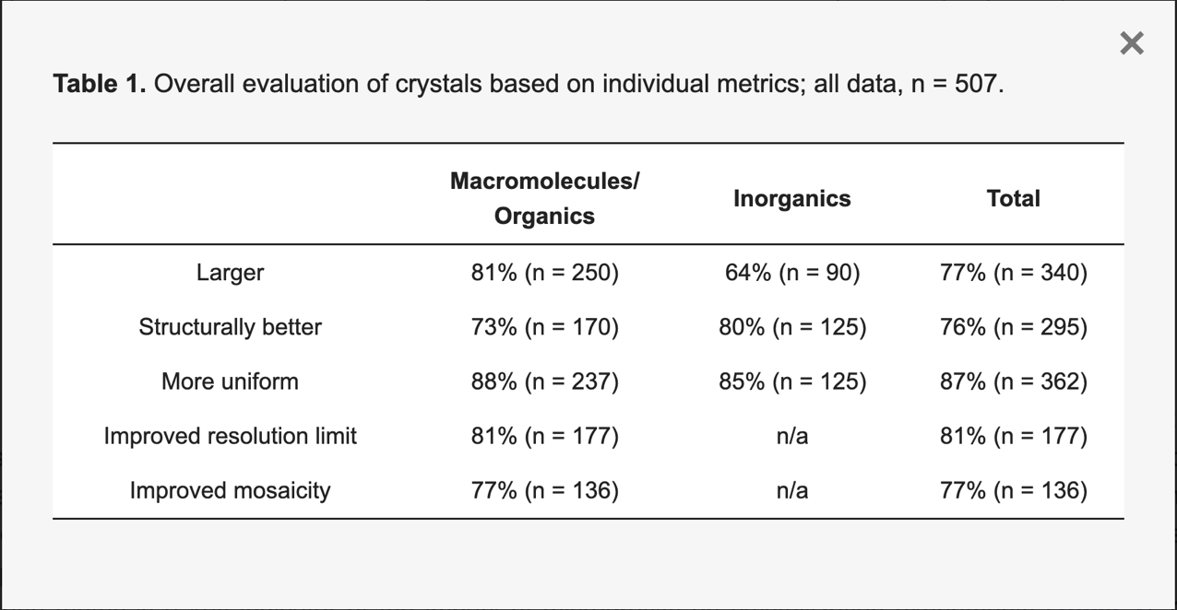
507 Crystals Grown in Space since 1973
Updates to the data of microgravity crystallization have upheld the conclusions of the preliminary report: microgravity was a beneficial environment for crystallization regardless of crystal type.
Microgravity Crystal Formation. Crystals 2024, 14(1), 12; doi.org/10.3390/cryst14010012

Slide 10
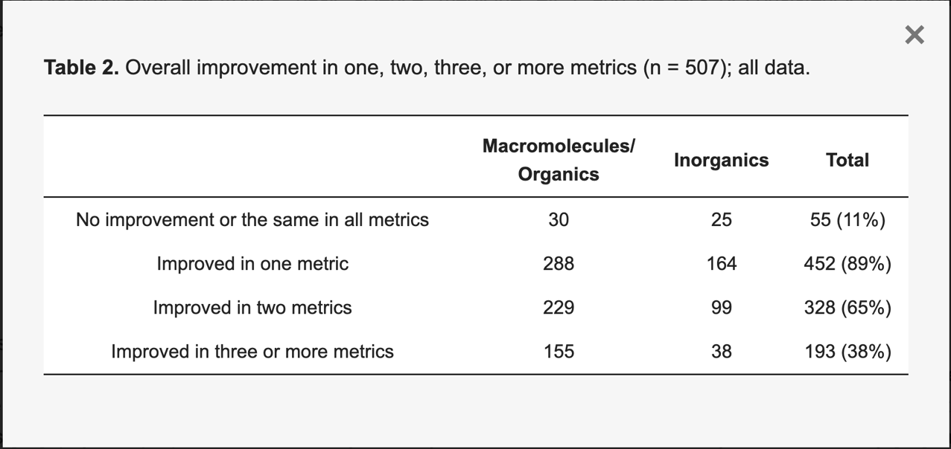
507 Crystals Grown in Space – Improvement in more than one parameter
Microgravity Crystal Formation. Crystals 2024, 14(1), 12; doi.org/10.3390/cryst14010012

Slide 11
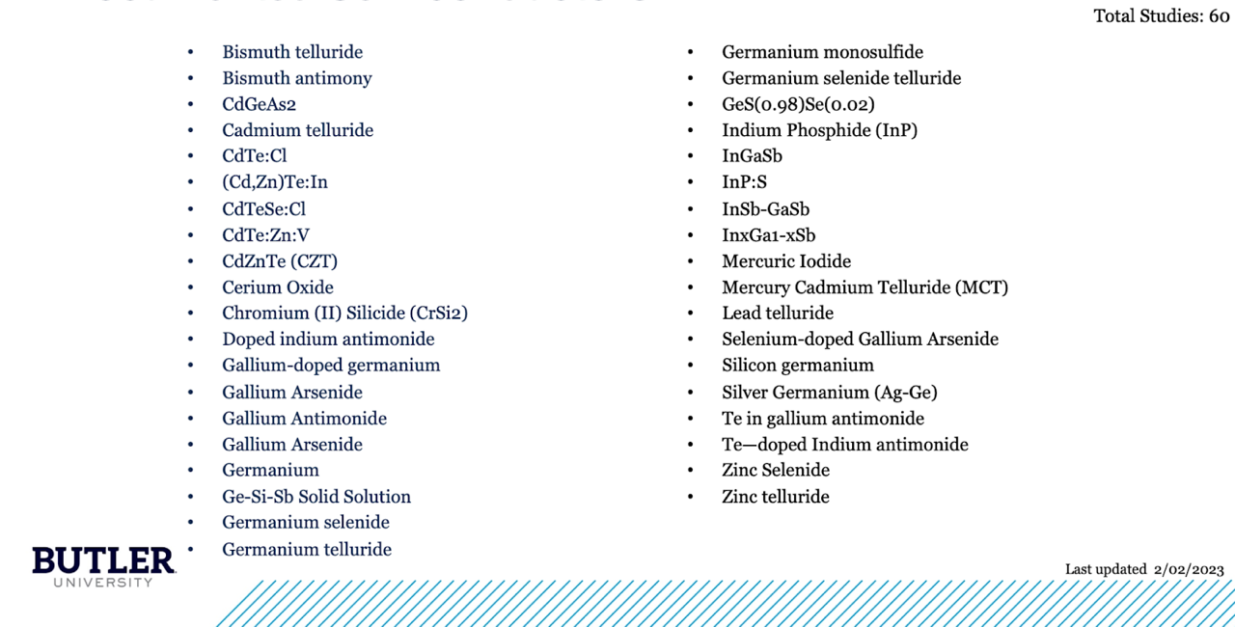
Documented Semiconductors Crystals Grown in Space 1973-2016

Slide 12
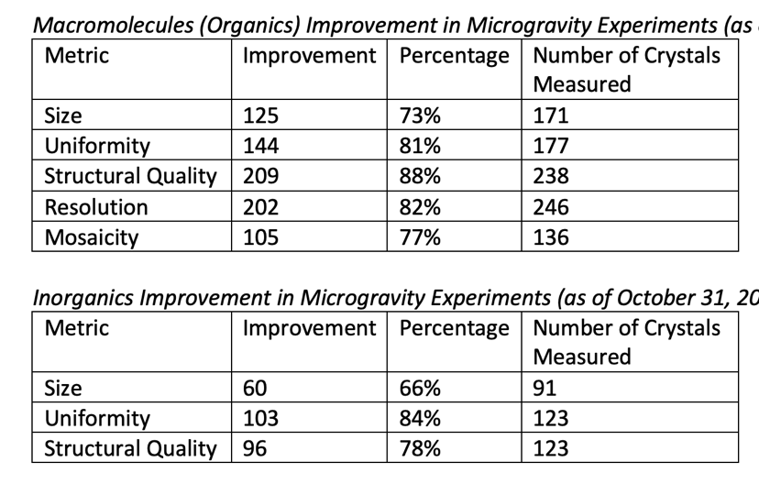
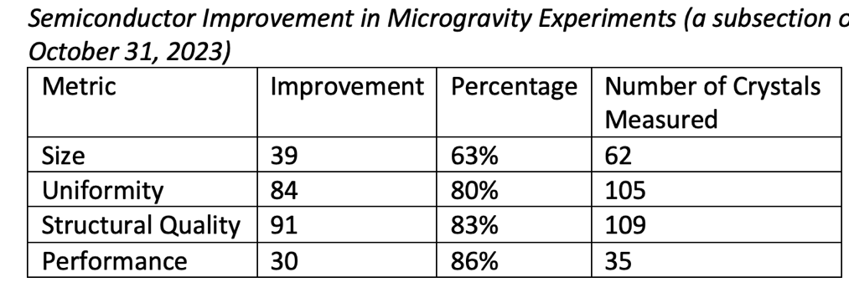
495 Crystals Grown in Microgravity Compared to Earth Over Past 50 Years
Crystals are bigger, more uniform, and have improved structural quality. Butler databases have been scrubbed of negative results from crystal data that failed due to technical failures (software/hardware), vibration from takeoff or landing, or other failures that impacted the experiment that had nothing to do with crystal formation. In addition, there is a column in each of the datasets that indicates if the results have been independently validated or are from the peer-reviewed literature.

Slide 13
It takes a village
InSPA
• Centers • Crew • CLDs • Inventors • Investors • Integration Partners • ISS • ISSNL/CASIS • Launch Services • MO&I • NASA BPS • NASA LEO Comm • NASA • OZ • NIH • NST • NSF • OGAs • Payload Services • Pharma • Safety • SBIR • Scientists • SHERPAs • SMEs • STMD Flight Opportunities • Technologists
• US Industries •

Slide 14
NASA InSPA and ISS National Lab Proposal Opportunities
On NSPIRES https://nspires.nasaprs.com/external/
Search for ISS NASA Research Announcement (NRA) NNJ13BG001N Focus Area 1 (InSPA)
See ISS National Lab Research Announcements https://www.issnationallab.org/research-on-the-iss/solicitations/

Slide 15
NASA InSPA Butler University Microgravity Crystal Database Downloads
Journal Articles with Database Links - DOI: 10.1021/acs.cgd.2c01056
An Analysis of Publicly Available Microgravity Crystallization Data: Emergent Themes Across Crystal Types. Hannah Wright, Amari Williams, Ashley Wilkinson, Lynn Harper, Ken Savin, and Anne M. Wilson. Crystal Growth & Design 2022 22 (12), 6849-6851. DOI: 10.1021/acs.cgd.2c01056
Microgravity Crystal Formation. Crystals 2024, 14(1), 12; doi.org/10.3390/cryst14010012
Wilkinson, A.; Brewer, F.; Wright, H.; Whiteside, B.; Williams, A.; Harper, L.; Wilson, A.M. Semiconductor Materials Fabricated in Microgravity; A Meta-Analysis. Discov. Mater. 2023; manuscript under review. [Google Scholar]
Direct download from Google Sheets:
The databases utilized for these studies can be found at the following links: macromolecules/organic compounds
—https://docs.google.com/spreadsheets/d/1JrXe4Drne7JKcU4EKG7ObQDfrm6EzrZkneTCrPyYZos/edit#gid=1461894258,
—https://docs.google.com/spreadsheets/d/1PZ8AAZlXYAln4d2UNR4x_zu-rpkWK8ByG04KiprAAXM/edit#gid=1518976417,

Slide 16
For Further Information
Kevin Engelbert, NASA, InSPA Portfolio Manager
kevin.englebert-1@nasa.gov
Curtis Hill, NASA, InSPA Lead for Semiconductors
Curtis.w.hill@nasa.gov
Dr. Rose Hernandez, Director InSPA for ISS National Lab
rhernandez@issnationallab.org

