Slide 1
ICE Cubes
15 February 2024
Educational Opportunities in Low Earth Orbit

Slide 2
agenda
15:00 - 15:05 - Introduction and welcoming words
Cynthia Bouthot, CEO & Founder, Space Commerce Matters
15:05 - 15:25 - ICE Cubes capabilities and case studies
Hilde Stenuit, ICE Cubes Business Development, Space Applications Services
15:25 - 15:35 - Funding opportunities in Europe
Laura Gonzalez, Terrestrial Markets and Networks Lead, Space Commerce Matters
15:35 - 15:45 - Discussion of projects and current educational programms

Slide 3
Introduction Cynthia Bouthot, SCM founder and ceo

Slide 4
ICE cubes Educational projects Hilde Stenuit, ICE Cubes Business Development

Slide 5
Funding opportunities

Slide 6
EUrope Funding Programs
Agency/Program ID | Program Name | Relevant Focus Area(s) | Max Award | Due Date
HORIZON | ERASMUS + | EU programme for education, training, youth and sport | TBD | TBD
HORIZON | Interconnected Innovation Ecosystems (2024.2) | HORIZON-EIE-2024-CONNECT-02 Expanding Academia-Enterprise Collaborations. Improved integration of research institutions, engagement and connectedness, competence, entrepreneurial skills. | 100-500k EUR | 19 Sept 2024
INDUSAC | INDUSAC | To develop and validate a state-of-the-art Industry-Academia Collaboration mechanism for quick, challenge-driven, human-centred co-creation. | 1,000 EUR per student 3,000 EUR per co-creation team | 7 March 2024
AFCEA | AFCEA European STEM Grants Program | Support to science, technology, engineering and mathematics (STEM) students and teachers. Projects funded year-by-year basis. | 1,000 USD | Rolling basis
COPERNICUS | Copernicus Academy | Earth Observation. Empower the next generation with suitable skill sets to use Copernicus data. Model for other STEM inter-university initiatives | TBD | TBD

Slide 7
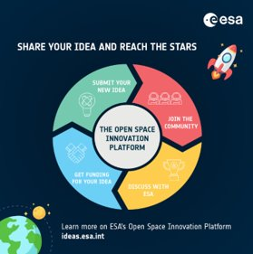
ESA Funding Programs
Agency/Program ID | Program Name | Relevant Focus Area(s) | Max Award | Due Date
ESA Academy | ESA Academy Experiments | Facility use: ICE cubes | Facility use costs | TBC
ESA OSIP | OSIP | Co-founded research (PhD / post-doctoral) | 175K € | Open
ESA | Current opportunities for university students | Training courses, competitions, challenges |  | Open
https://www.esa.int/Education/ESA_Academy/Current_opportunities_for_university_student
ESA Academy Experiments
Funding body: ESA
Opening date: TBC
Last round closed 3 Dec 2023
Project duration: 1.5 years
Team:
The core team minimum of six students
The team leader recommended to be PhD student
https://www.esa.int/Education/ESA_Academy_Experiments_programme/How_to_apply
Open Space Innovation Platform
Funding body: ESA
Call open, funding for ideas
Co-founded research (PhD / post-doctoral)
Up to 175k EUR
https://technology.esa.int/page/funding-your-ideas

Slide 8
elgra
selgra
European Low Gravity Association
Non-profit international society
Promotion of scientific research under various gravity conditions in Europe.
Provides a networking platform for all scientists interested in life and physical sciences and technology in space or on ground.
Biennial Symposium & General Assembly
Sept 2-6 2024, Liverpool, UK
Abstract submission opened until Thurs 29th Feb
Registration will open in March
https://www.elgra.org/abstract-submission-portal-for-the-2024-european-low-gravity-research-association-elgra-meeting-is-live/
The ELGRA Research Prize:
Enables members of ELGRA holding a PhD to pursue small-scale research projects in the field of Life Science or Physical gravity-related research
Deadline for applications: 15th March
Funding: 10,000 Eur
Duration: 1 year
https://www.elgra.org/wp-content/uploads/2024/02/ELGRA-RESEARCH-PRIZE-2023-24ext.pdf
Student
European Low Gravity Association
SELGRA is the Student chapter of the European Low Gravity Research Association aiming to be the point of reference for gravity-related students all over Europe.
https://sites.google.com/site/studentelgra
​
https://www.elgra.org/​

Slide 9
research Funding Programs
Agency/Program | Program Name | Relevant Focus Area(s) | Country | Duration | Max Award | Due Date
Portuguese Space Agency | PROSSE - PRODEX | Science onboard ISS platforms relevant for space exploration or other sectors in society. | Portugal | 36 months | 280k € | 24 March 2024
German Space Agency at DLR | InnoSpace Masters - DLR Challenge 2024: "Applied Research for Disruptive Innovation" | Tech demos. Digital Technologies, On-Orbit Economy, Sustainability, Biotechnologies. E.g: tissue engineering, development of novel materials or pharmaceutical agents in microgravity | Germany | 2 years | 500k € | 23 April 2024
UK Research and Innovation (UKRI) | Funding for early stage development of new healthcare interventions | Healthcare. Generate critical preliminary data to build confidence in the development strategy for a new medicine, medical device or other medical intervention development. | UK | 6-24 months | £50k -300k | 13 March 2024
UK Research and Innovation (UKRI) | UK Japan Engineering Biology for Novel Therapies and Diagnostics Research Collaboration | Protein crystallization service Kirara, in collaboration with Japanese partner (e.g. JAMSS) | UK | 3 years |  | 16 April 2024

Slide 10
Discussion:
What are your project concepts?
What are the educational grants you currently work with and how can we “flybolize” them?
Questions!

Slide 11
Thank you for your attention
Contact us!
laura@spacecommatters.com
https://calendly.com/laura-scm/30min

Slide 12
Back up slides

Slide 13
PORTUGAL: PROSSE
PROSSE
Funding body: Portuguese Space Agency
Call open
Due Date: 29th of March
Maximum budget per project: 280k €
Maximum duration of the project: 36 months
Focus: activities related to the use of space analog facilities and locations, microgravity platforms, radiation facilities, or the International Space Station itself that can lead to relevant developments for space exploration or conduct research and development for other sectors, such as the pharmaceutical sector, benefiting from the unique conditions of space.
http://PTS_PRODEX_PROSSE_RE_001010_Regulamento-PROSSE_PT_v03.pdf​

Slide 14
germany: INNOspace Masters
INNOspace Masters
Funding body: German Space Agency, DLR
Submission phase starts: 15 February 2024
Submission phase and ends: 23 April 2024
Possible funding for each project: EUR 500,000
Period: Up to 2 years
Ideas can range from basic applied research up to technology demonstrators.
This year’s DLR Challenge impulse topics include, but are not limited to:
Digital technologies for and from space, e.g. artificial intelligence, swarm intelligence and visual computing; quantum innovation for space; intelligent & connected sensor systems; and more
On-orbit economy, e.g. development of novel materials or pharmaceutical agents in microgravity; autonomous orbital manufacturing processes; and more
Sustainability in space and for Earth, e.g. space debris protection and mitigation; advance monitoring of environmental and social sustainability on Earth; and more
Biotechnologies for space and Earth, e.g. bioprocessing methods for in-space nutrient extraction from crops or (food) waste; tissue engineering in microgravity; and more
https://innospace-masters.de/challenges/

Slide 15
UK: UKRI NEW HEALTHCARE INTERVENTIONS
Funding for early stage development of new healthcare interventions
Funding body: UK Research and Innovation (UKRI), Medical Research Council (MRC)
Due Date: 13th of March 2024
Budget per project: £50k -300k
Project duration: Between 6 and 24 months
Focus areas:
Generate critical preliminary data to build confidence in the development strategy for a new medicine, repurposed medicine, medical device, diagnostic test, or other medical intervention development.
https://www.ukri.org/opportunity/funding-for-early-stage-development-of-new-healthcare-interventions/

Slide 16
UK: UKRI Japan collaboration
UK Japan Engineering Biology for Novel Therapies and Diagnostics Research Collaboration
Funding body: UK Research and Innovation (UKRI), Medical Research Council (MRC)
Due Date: 16th of April 2024
Project duration: Up to 3 years
Looking for internationally competitive, full-scale collaborative and innovative partnerships.
MRC will provide matched funding and bi-lateral support with the Japan Agency for Medical Research and Development (AMED). MRC will make up to £3 million available in support of the UK components.
Focus: Research projects focused on engineering biology for novel therapies and diagnostics research.
Specific objectives:
joint academic research projects with the potential to further the field of engineering biology and enable progress towards novel therapies and diagnostics
development of new and enhancement of existing partnerships to foster sustainable research links between the UK and Japan
the exchange of scientists between the two countries, particularly considering the development of the next generation of top researchers that will contribute to the promotion of international talent mobility
knowledge or methodology exchange between the two countries
complementary access to facilities, resources, and equipment
stronger opportunity for collaborative research and catalysis of further synergy
https://www.ukri.org/opportunity/uk-japan-engineering-biology-for-novel-therapies-and-diagnostics-research-collaboration/

Slide 17
ESA: ESA Academy Petri
ESA Academy Experiments
Funding body: ESA
Opening date: TBC. Last round closed 3 Dec 2023
Project duration: 1.5 years
Team:
The core team minimum of six students
The team leader or systems engineer, ensuring the milestones and deadlines of the programme are met, must be enrolled for at least two more years and is therefore recommended to be a PhD student and must be part of the core team.
https://www.esa.int/Education/ESA_Academy_Experiments_programme/How_to_apply
Open Space Innovation Platform
Funding body: ESA
Call open, funding for ideas
Co-founded research (PhD / post-doctoral0 up to 175k EUR
https://technology.esa.int/page/funding-your-ideas

Slide 18
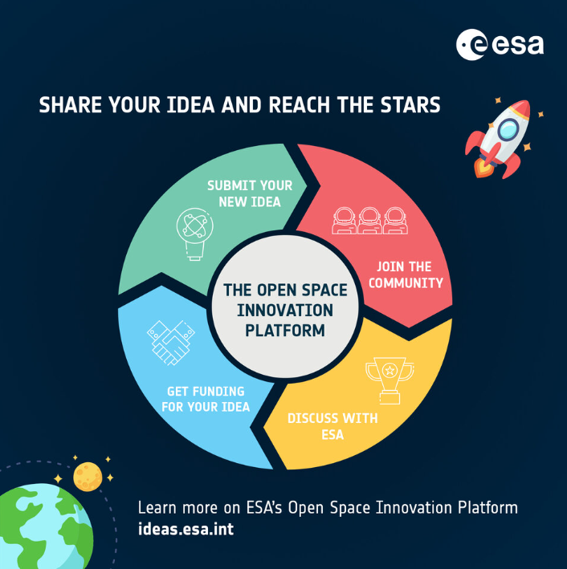
esa: OSIP
Open Space Innovation Platform
Funding body: ESA
Call open, funding for ideas
Co-founded research (PhD / post-doctoral0 up to 175k EUR
https://technology.esa.int/page/funding-your-ideas
ESA launched OSIP to better serve the emerging needs of the modern space sector.
The platform is the main entry point for novel ideas into ESA, both in response to specific problems and through open calls for ideas.
Anybody is welcome to submit ideas for new space technologies and applications via OSIP.
The platform supports individuals who wish to contribute to European space research and interact with space industry experts.
Encourages ideas from legal entities interested in interacting with ESA and gaining funding or support for new research activities.

Slide 19
EUROPE: eureka
Eurostars Funding Programme
Funding body: EUREKA + HORIZON
Due Date: Sept 2024
Eurostars is a funding instrument that supports innovative SMEs and project partners (large companies, universities, research organisations and other types of organisations) by funding international collaborative R&D and innovation projects. By participating, organisations can access public funding for international collaborative R&D projects in all fields.
Key:
Define your project idea.
Collaborate internationally, sharing expertise.
Develop products, processes or services that can be easily commercialised.
https://www.eurekanetwork.org/open-calls/eurostars-funding-programme-2024-call-7
Hilde, is this call relevant for you?

